Slide 1
BETA 2022
Preventing Wormer Resistance
Development in Horses
Sally Harmer

Slide 2
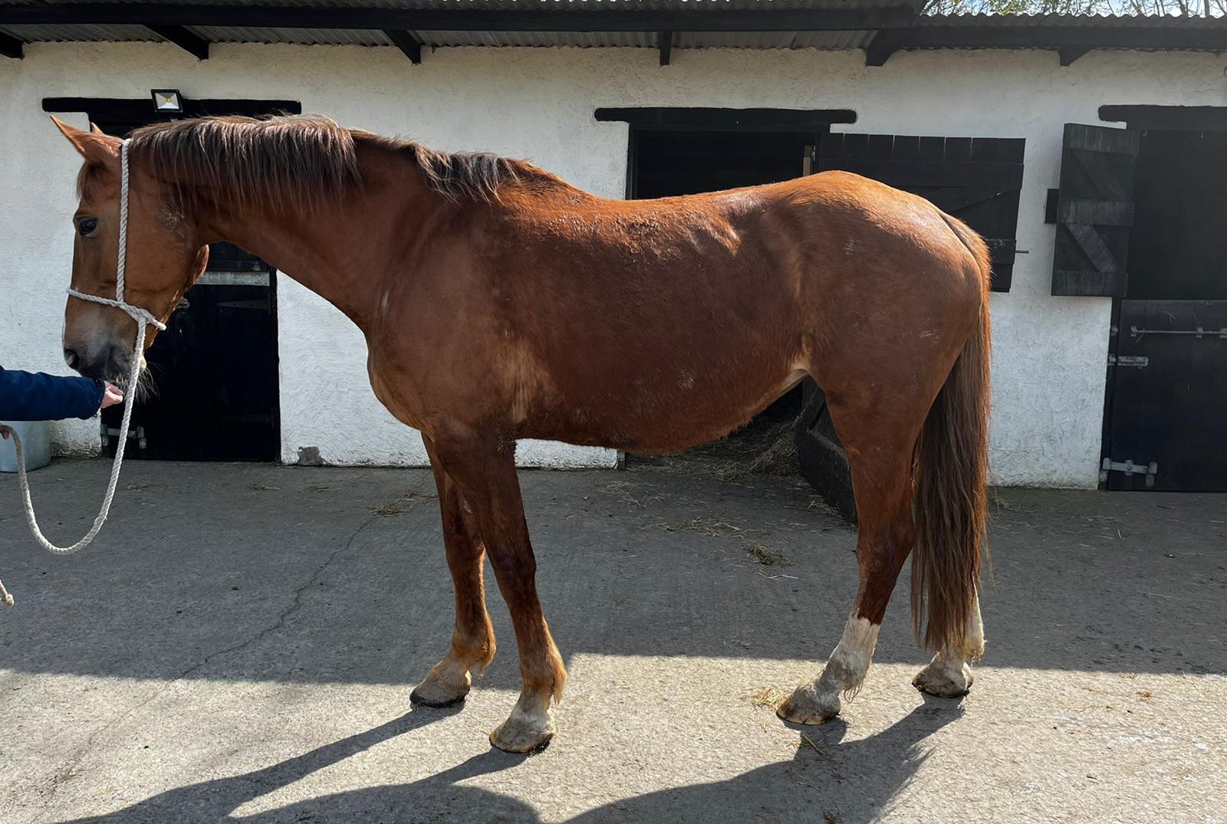
Introduction
Increasing wormer resistance is a very real problem in the equine world and we are in the situation now, where some wormers just do not work anymore.
The more horses are wormed, the more resistance issues they will have. This presentation is on advising what horse owners can do to reduce wormer treatments focussing on testing,
quarantine dosing and pasture
management.

Slide 3
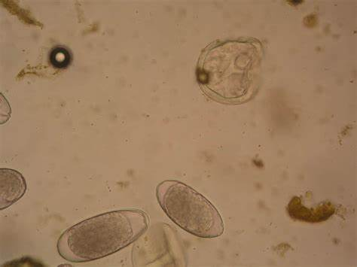
What is Wormer Resistance?
Anthelmintic (or wormer) resistance is the ability of worms to survive the normal dose of a wormer and pass that ability on to its offspring.
This results in the proportion of resistant worms in the population increasing over time.
Worms can be resistant to one class or
several classes of wormer.
It is important to note that any offspring of
these worms will also be resistant.

Slide 4
What Happens if Wormers Don’t Work?
You will always have a parasite burden on your fields
Adult animals will develop some immunity but younger animals could have real issues
And you won’t be able to control a worm infestation by chemical means
In Agriculture there are farms that cannot carry livestock anymore due to wormer resistance

Slide 5
The Problem Parasites
Not going into lots of detail here but all horses can have or do have roundworms.
Tapeworms are not resistant to wormer although it is sensible to quarantine dose against them
Foals and youngsters – are most at risk as don’t have immunity to the worms
Older horses – their immunity can drop with age

Slide 6
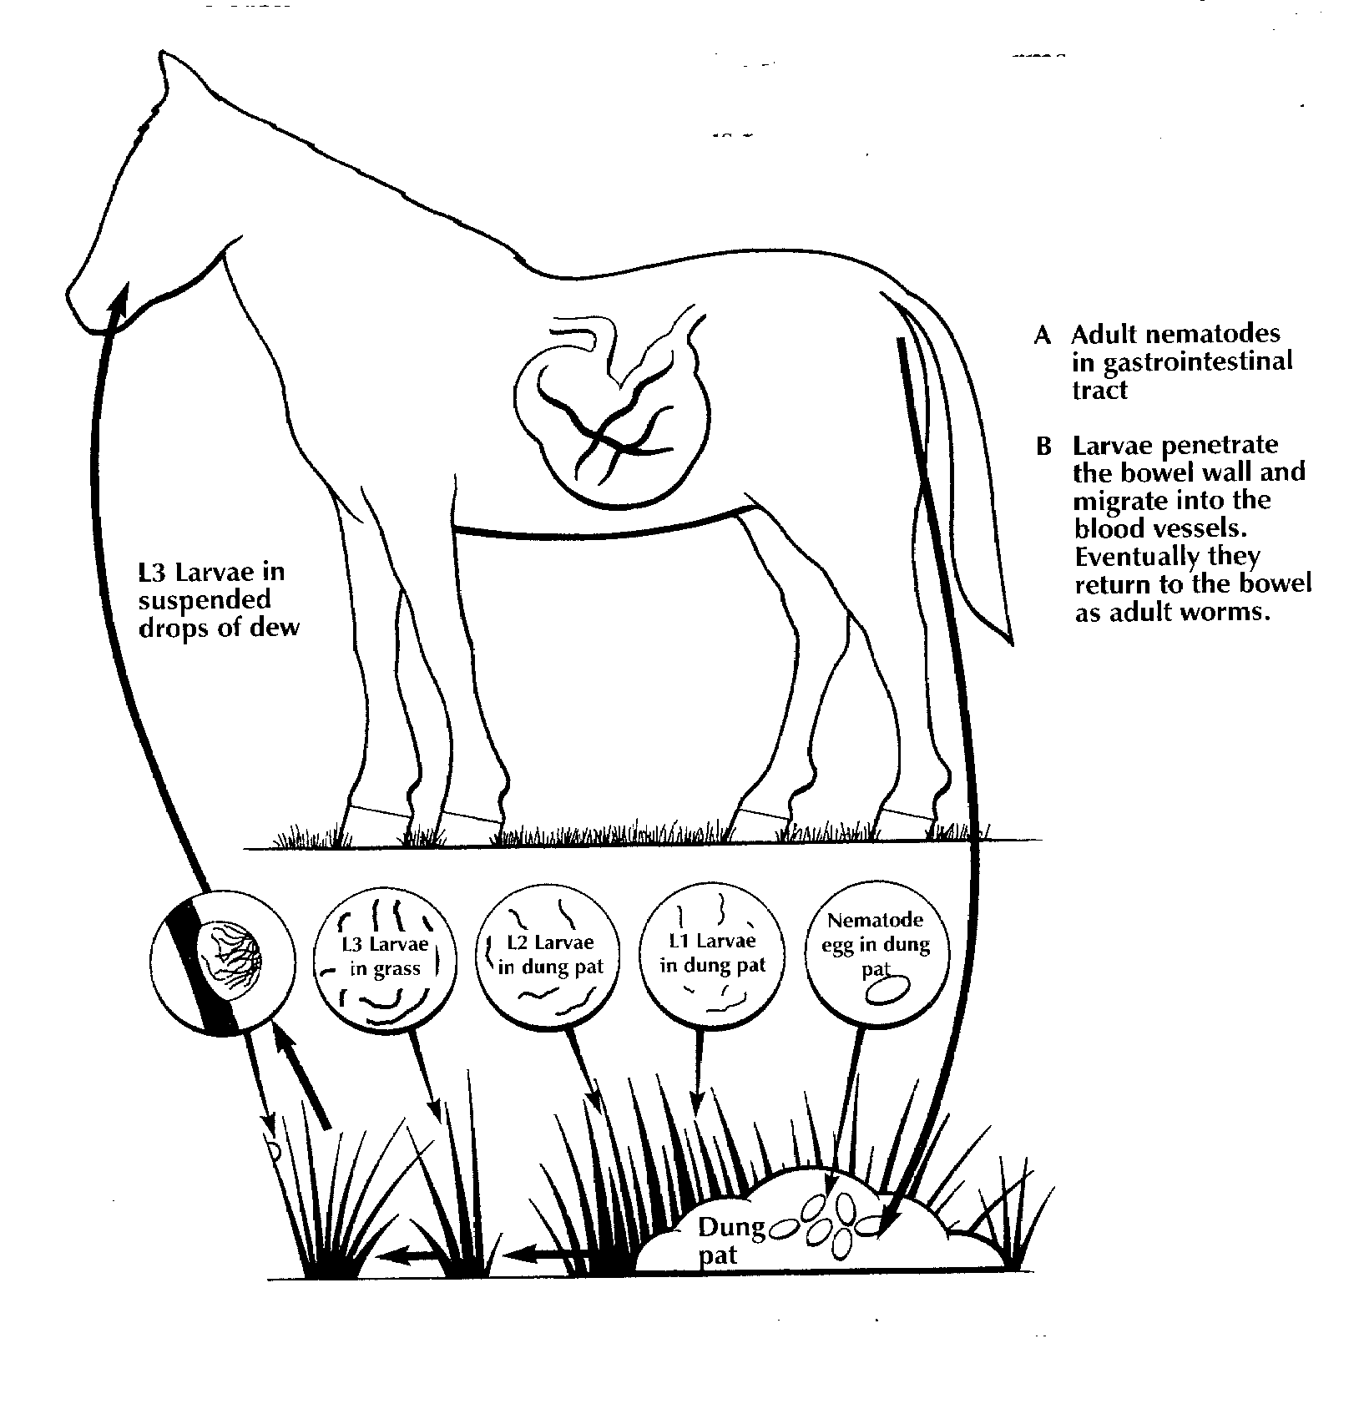
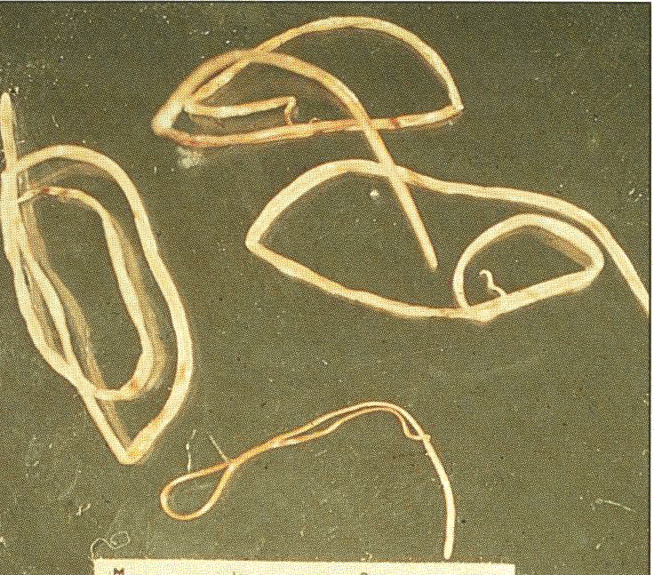
Roundworm Lifecycle

Slide 7
Encysted Redworms – a resistant worm
These are Roundworms but…
Small redworms are the most common internal parasite in horses
The normal lifecycle normally takes place in a matter of weeks but these worms can encyst in the gut wall during the winter months.
At this stage the worms become problematic as there are very few wormers that will kill them.
The emergence of lots of larvae all at the same time (usually during the late winter) can cause huge damage to the gut lining.

Slide 8
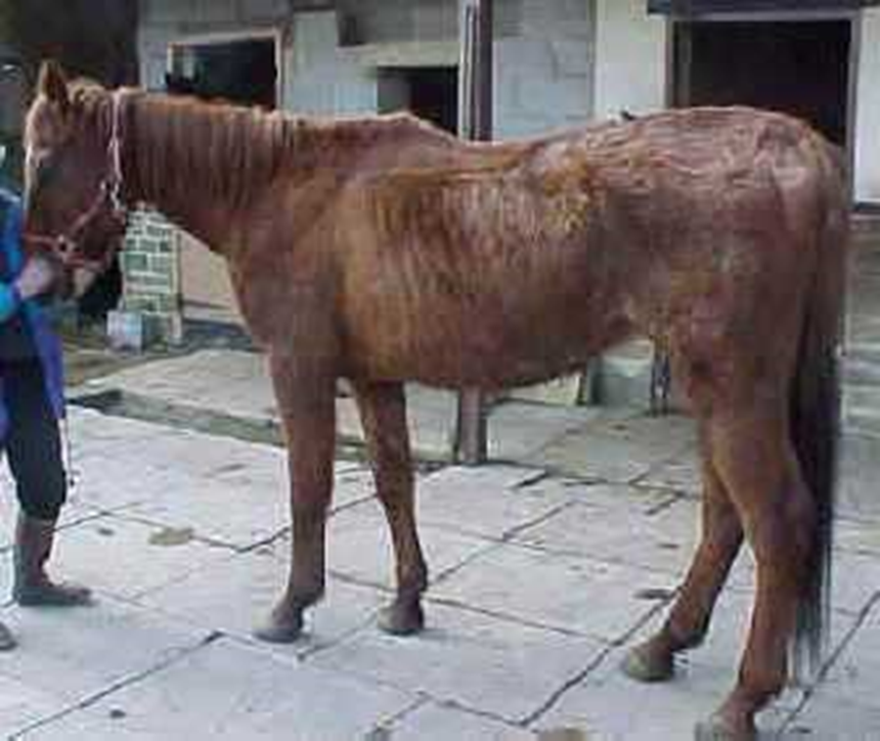
Issues Roundworms Can Cause
Weight loss
Pot Belly, especially in foals
Colic
Death in severe cases
A lot of the time (with the exception of foals) they don’t cause an issue especially if there is some form of worming and grazing strategy followed
Notes:
Dull, rough haircoat
Lethargy
Wt. Loss
Coughing or nasal discharge
Tail rubbing
Colic
Summer sores

Slide 9
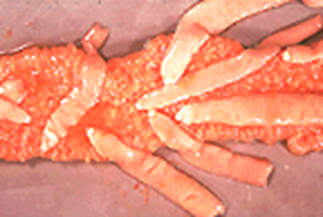
The Parasites - Tapeworms
All ages of horses apart from foals can have tapeworms. However quite a lot don’t have.
Severe Tapeworm Infections can cause
  Digestive disturbances
  Loss of condition
  Colic and sometimes death.
Wormer resistance is not an issue
Mixed grazing and new pastures can
help

Slide 10
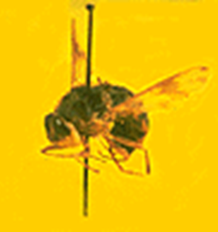
Bots
The female Bot flies lay yellow eggs on the horse’s coat in the summer; typically on the forelegs, shoulder or abdomen.
As the horse licks itself, the eggs hatch and the larvae are transferred into the horse’s mouth and into the stomach.
The larvae attach themselves to the gut lining to continue their development through the winter. They are then passed out in the dung to emerge as a new generation of flies.
Daily removal of the eggs from your horse with a bot knife reduces their numbers. You may need to use certain types of wormer to remove a burden in a horse in late autumn but resistance is not an issue.

Slide 11
What Is Worm Resistance?
Resistance is when the bulk of worms, usually affected by a dose or concentration of compound, are no longer affected. Their offspring will also be resistant.
Once resistance is present in a worm population, the health, welfare and performance of horses infested with resistant worms will be compromised.

Slide 12
Why does it develop?
There are 2 main reasons..
Under dosing wormer may speed up the development of resistance. For this reason it is essential that the Horse or Pony is dosed accurately according to bodyweight.
Unnecessary worming or over-worming
  will also increase the potential for
  development of resistance.

Slide 13
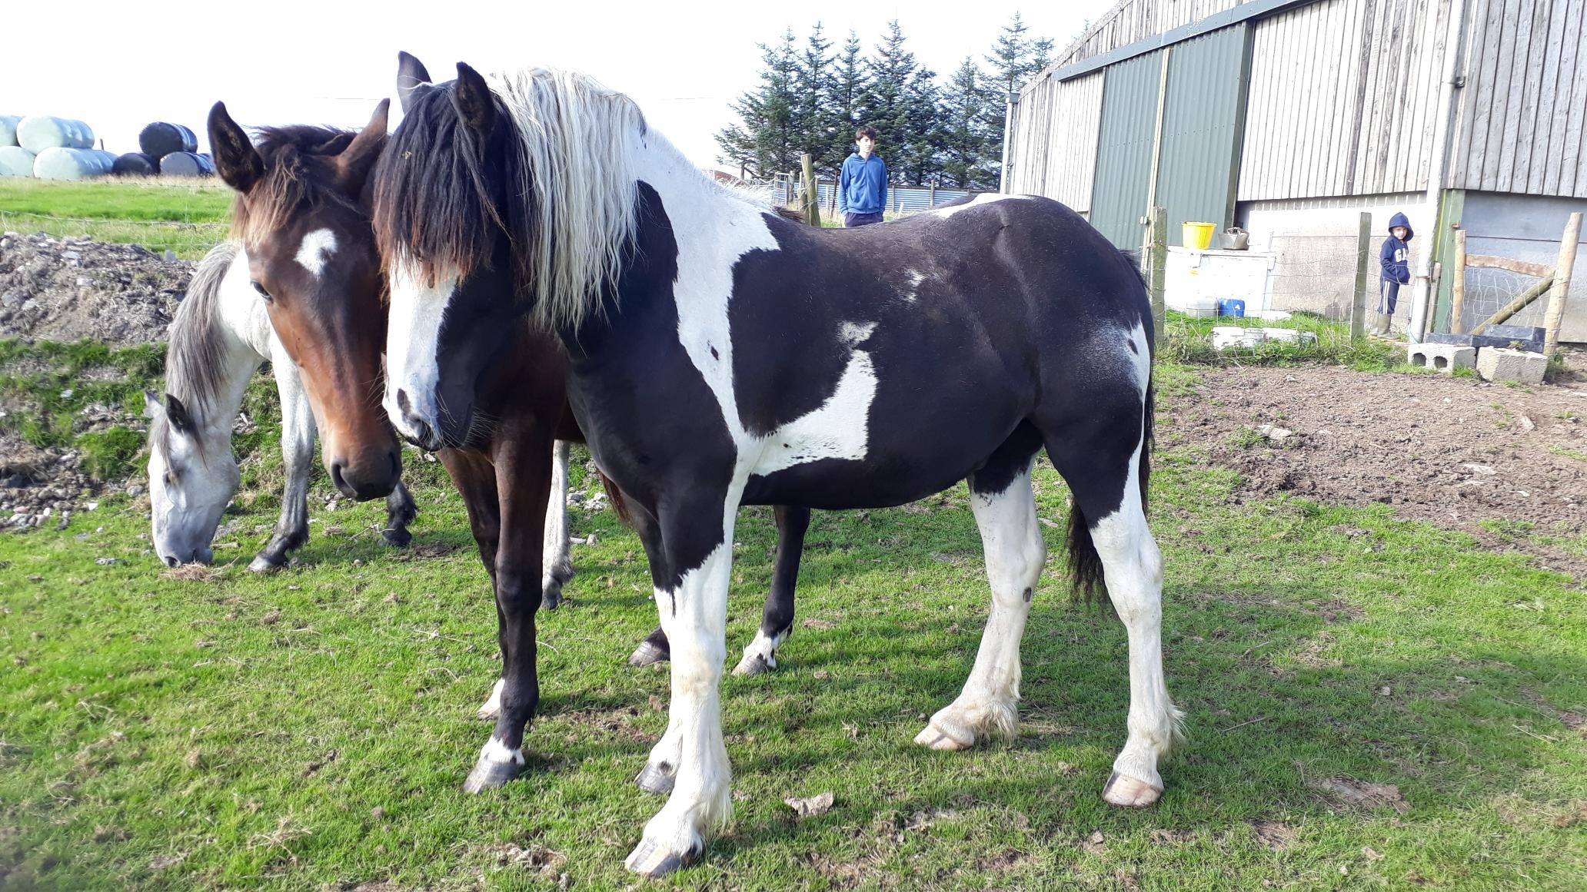
Quiz 1
Name 3 signs of Parasites in a Horse or Pony?
What are the 3 main groups of internal Parasites?
How do you confirm if your horse has Internal Parasites?

Slide 14
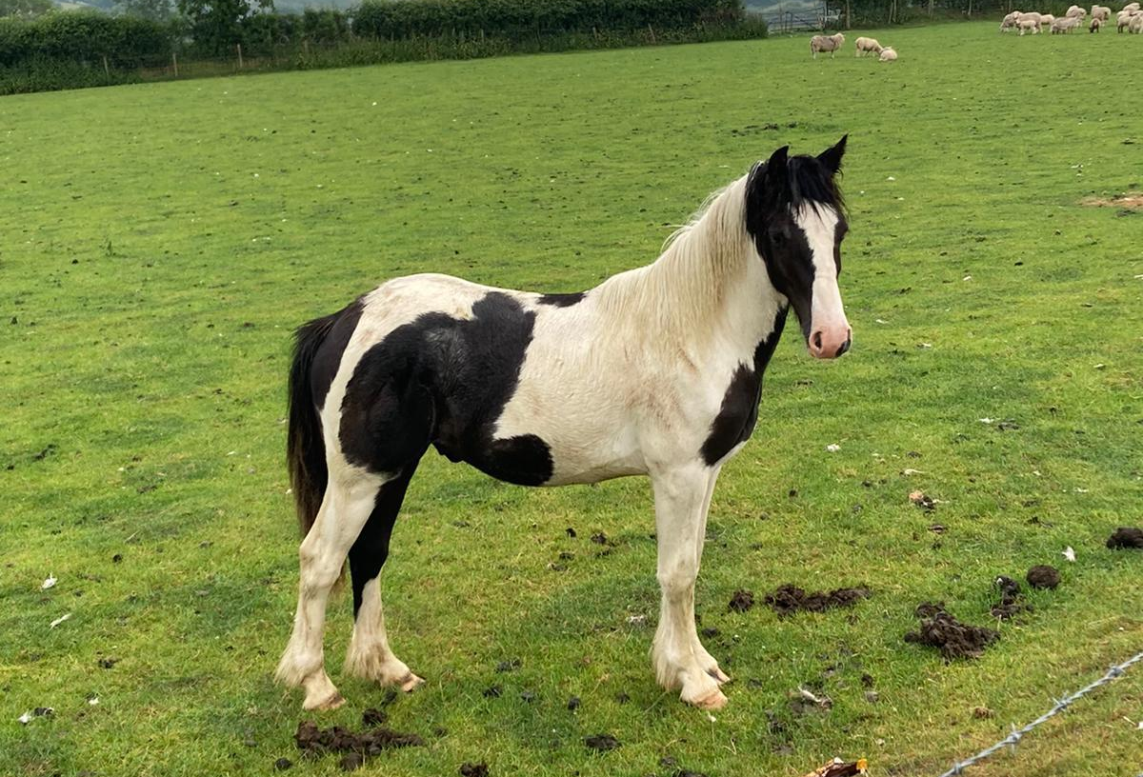
Other Information that can influence prescribing
Age
Weight
Any Health Issues
Has it been tested?
Grazing Group

Slide 15
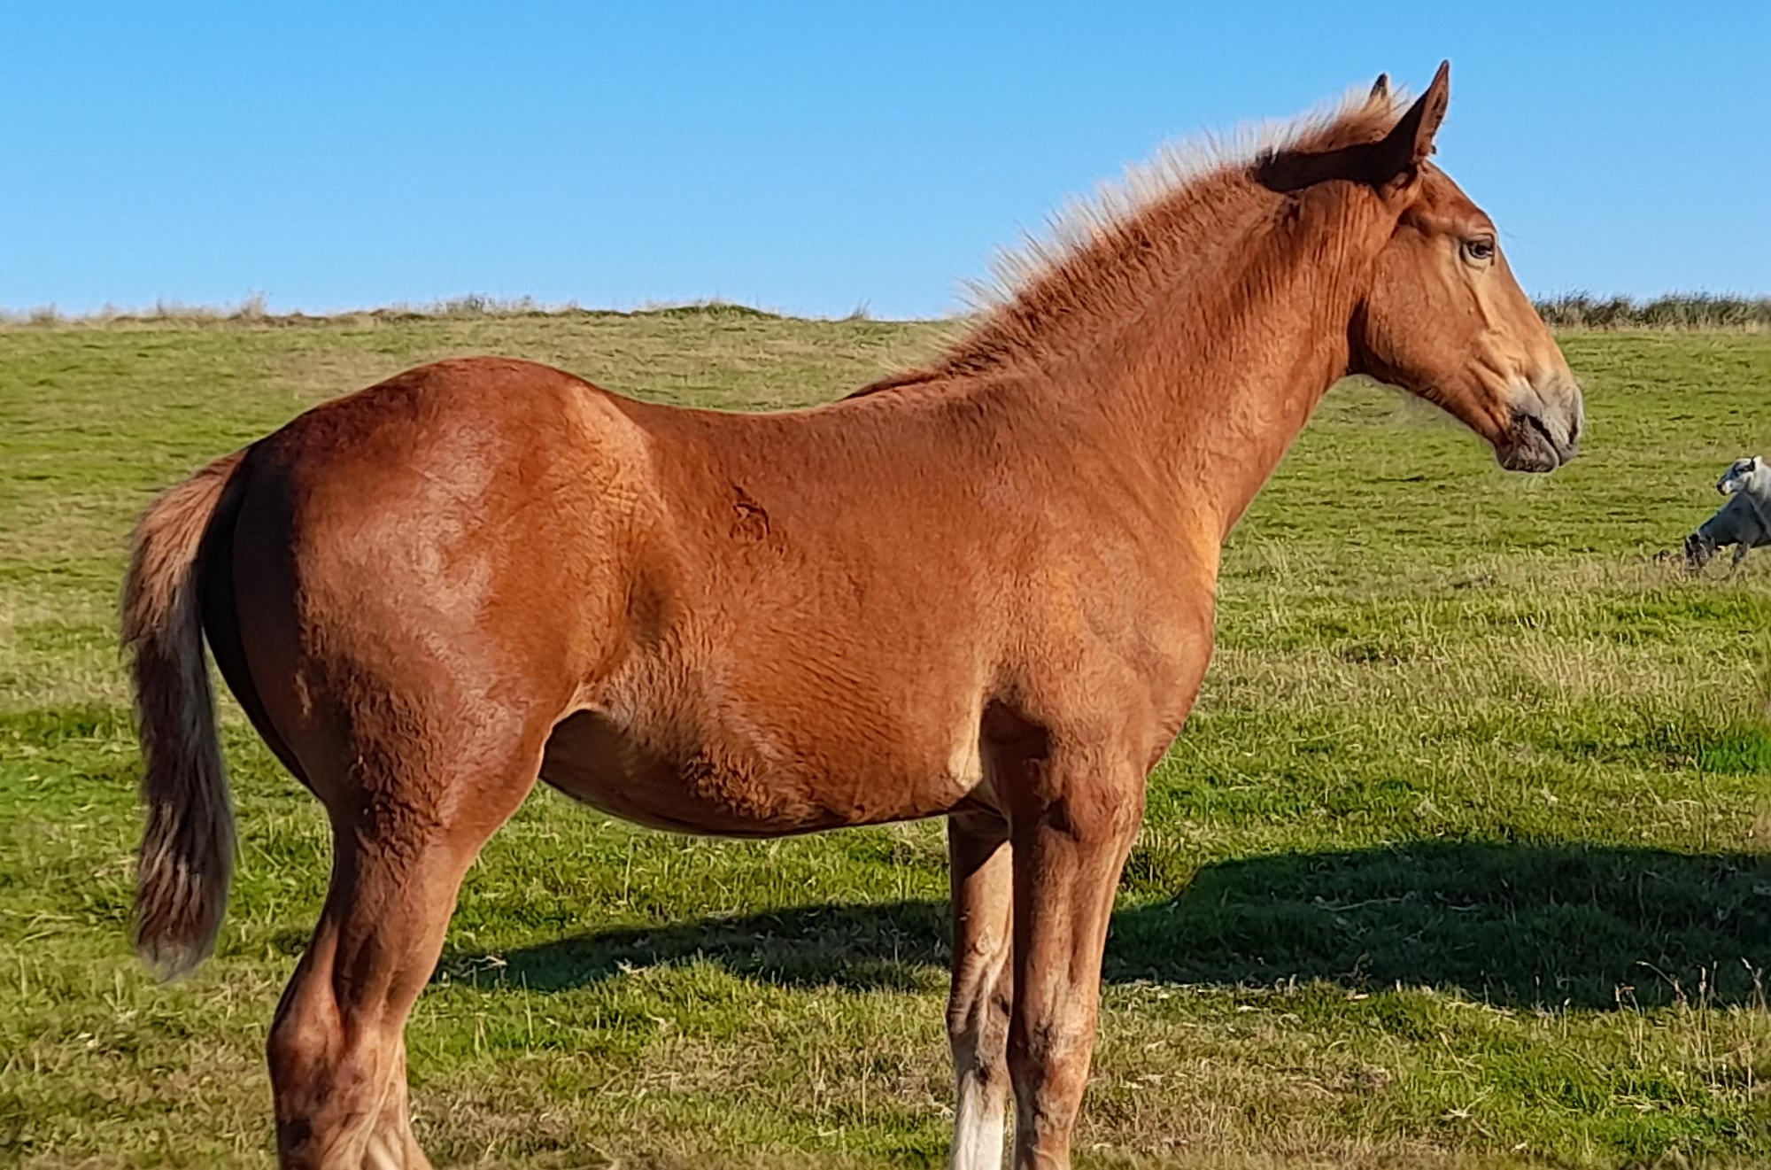
Age of Horses and Ponies
Why does it Matter?
Some wormers are contra indicated for young animals.
Younger animals are more susceptible to worms as have not developed immunity
Foals can get certain worms via their Mums
Older animals can have their immunity to worms drop off which makes them more susceptible to parasites.

Slide 16
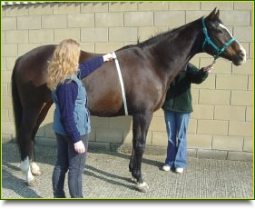
How do you find out the Animals Weight?
Use a weigh tape. Work out the weight and add 10%
Use a weigh bridge.
It is handy to know weights for feed
purposes too

Slide 17
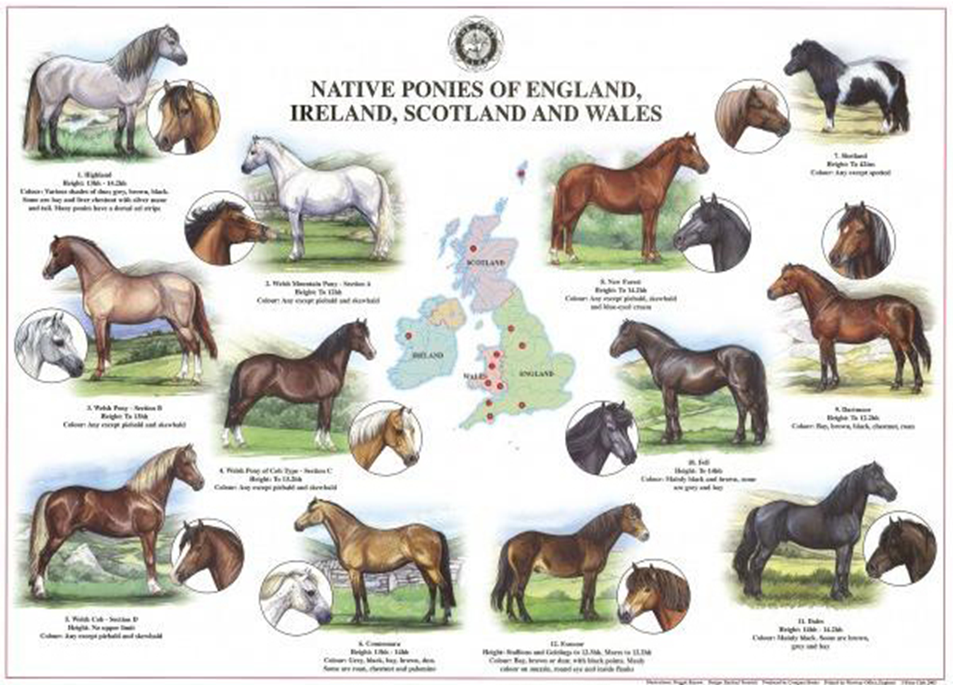
Range in adult Horses and Ponies can be <150kg to >1200kg!

Slide 18
Why is Underdosing Such a Factor with Resistance Development?
No wormer is 100% effective even if brand new.
If the horse or pony get a smaller amount of wormer than it needs then this can leave a bigger proportion of worms surviving.
They will be more resistant too
Also they will reproduce and their offspring will also be resistant.
This speeds up development of wormer resistance a lot.

Slide 19
Quiz 2
What are the 2 main ways of finding out the weight of a horse or pony?
What is the weight variation in adult equines?
Why is it important to know the weight?

Slide 20
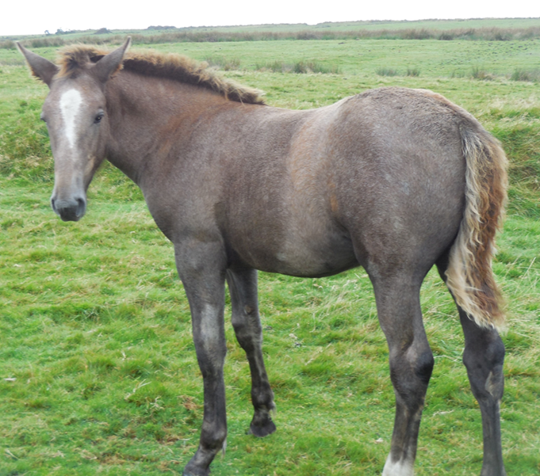
Testing – why it matters?
Worm egg counting has an important role in reducing resistance issues, as it help to identify if your horse actually needs to be wormed.
Use worm egg counts as part of a SMART worming programme.
Simply Monitor and Assess the Risk and Treat accordingly.

Slide 21
Advantages of Testing
It’s much better to test first and target the wormers at the wormy horses and at specific seasonal issues like encysted redworms, bots and pinworm. Using wormers sparingly should also mean that work for longer and will work when horses really need them
Targeted use tends to work in most situations. Redworm, roundworm & tapeworm are the biggest parasite threats to horses and are the parasites for which you should test regularly
If you are getting good results with a worm control programme then you can widen the gaps between counts as time goes on, but it is important to worm count and test regularly
Don't forget about encysted redworm in the winter, as
parasites can remain in the dormant larval stage for a
long time.

Slide 22
Three Types of Tests Available
There are three tests that should form the basis of an effective targeted worm control programme – worm egg counts for redworm and roundworm and the EquiSal saliva test for tapeworm. There is a blood test available for encysted redworm through the veterinary practices too.
All tests can give results for the levels of parasites present that can be used to determine whether the horse needs treatment or not.
You may also need to consider bots, pinworm, lungworm and liver fluke in your programme if you suspect a problem.

Slide 23
How often should horses be tested?
In most years a healthy adult horse can follow a very simple plan of testing and dosing, worm egg counting Spring to Autumn, with tapeworm testing every 6 months and giving a proactive winter dose for the possibility of encysted redworm although ideally horses should be tested.
Some weather conditions can significantly increase parasite burdens. In those conditions we may need to reduce the time between worm counts to 8 weeks particularly with young, old or vulnerable horses.
We should also look to break the lifecycle of the worms mechanically as much as possible with pasture
management and target with the right wormer at the
right time.

Slide 24
What do test results tell us?
If we need to treat – typically over 200epg
Can give an indication of pasture contamination
To check for resistant worms; if a positive result is found, treat the horse then sample again in about 10-14 days. If the wormer has been effective the second count should be either ‘no eggs seen’ or very low.

Slide 25
Worm Egg Counting Advice
There are a number of test kits available commercially.
Doing a WEC is simple. It should be done at 6-8 week intervals after worming (depending on the product) or at similar intervals if no worming has taken place.
Simply collect a small sample of fresh dung, double-bag it and place this in the envelope provided and post that day. Ideally it should be put it in the fridge until posting.
The results will be sent to the owner, along with recommendations for the next course of action: worm or wait and retest.
Unfortunately Encysted Redworm cannot be detected this way but there is a blood test available through Veterinary Practices.
Tapeworm is tested for using a Saliva test.

Slide 26
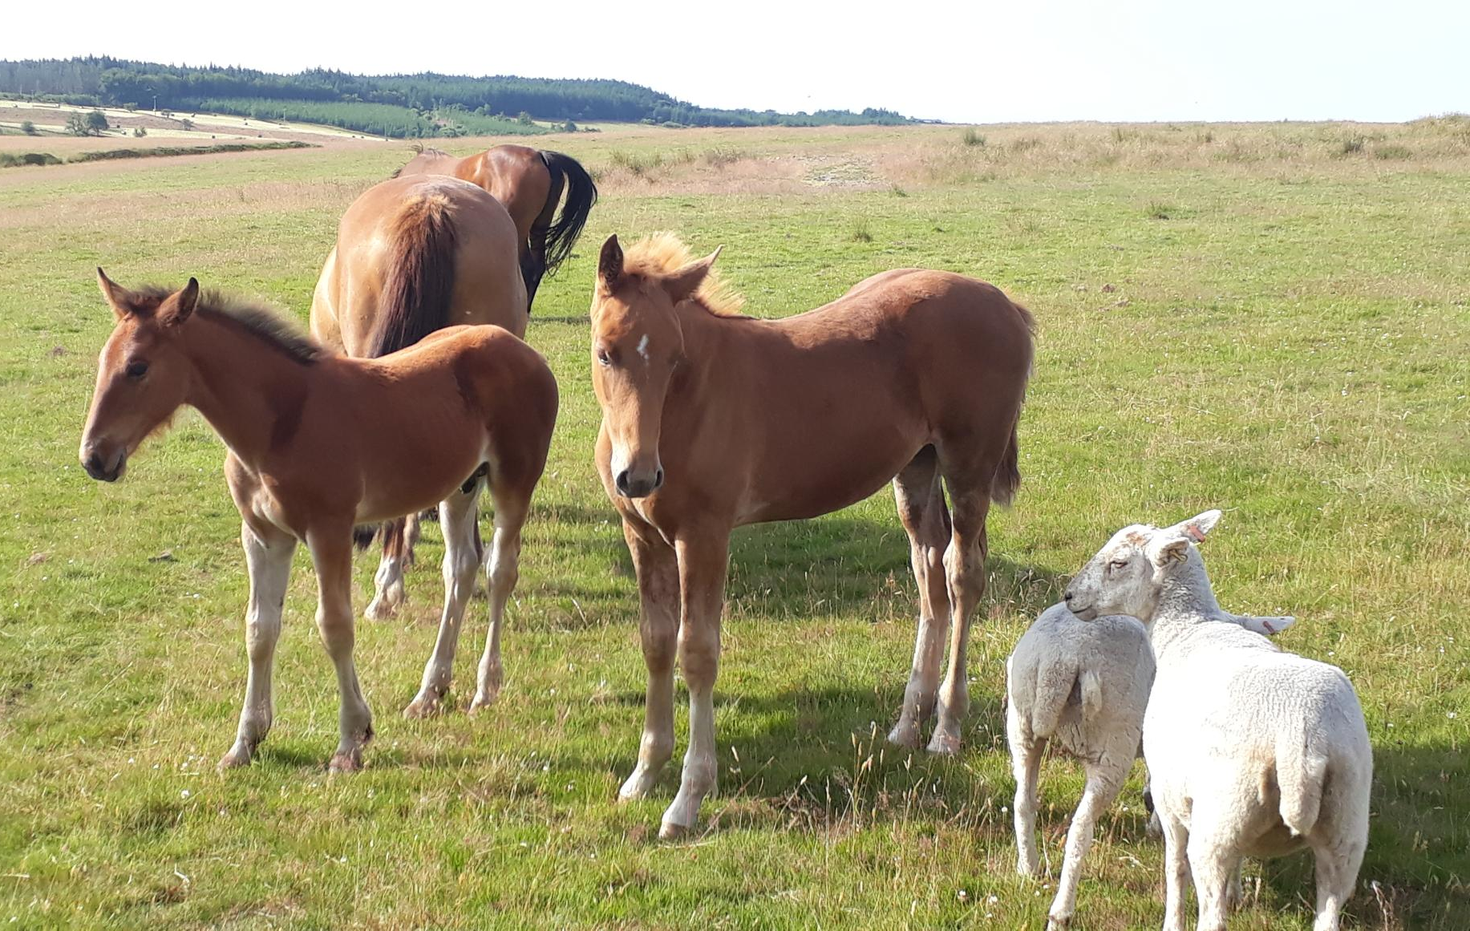
Other factors that can help reduce worms
Good pasture management and other husbandry techniques will also help to reduce reliance on chemicals to control a horse’s worm burden. Key tips are below:
Horses are herd animals so keep horses with the same grazing companions. Rest and rotate grazing and don’t overcrowd fields.
Poo-pick as much as possible, at least twice a week to keep parasite levels down.
Cross graze pasture with other species e.g. sheep and/or cattle.
When first starting on a targeted worm control programme all horses should be tested when worming is due or slightly overdue so as to get a true result.

Slide 27
Other Stable and Grazing Advice
Don’t worm and move; after worming ensure horses stay on the same pasture for a few days to help slow down resistance.
Horses normally don’t pick up most worms if inside (Pinworms excepted). Adjustment of treatments may be needed therefore.
Testing can really help.
Try to rotate wormers throughout the year using as many groups as you can.

Slide 28
New Horse or Pony?
Quarantine new horses until tested and treated accordingly.
Find out worming history.
Do a test if possible for roundworm, encysted redworm and tapeworm
Ideally they should be stabled for 24hrs if possible. Then turn out onto dirty pastures.
Ideally test before worming and about 2 weeks after to check the wormer has worked as expected.
Poo pick and dispose of dung on a dung heap.
Use the wormer group with least resistance
Ensure they get the correct dose

Slide 29
Other Considerations
Competency of the owner to treat correctly
  Are they very young?
  Or old
The horse or pony
  Is it haltered and quiet
These can make a difference if the
animal gets the full dose or not

Slide 30
Quiz 3
Name two methods of managing pastures better?
What should be done with new arrivals on a yard?
Name 2 of the 3 worming strategies?
Name 2 factors that can affect dosing intervals?
Name 2 things to consider when dosing?

Slide 31
When do you need to Worm Horses and Ponies?
Lots of Factors can affect this such as…
  Quarantine Dosing
  Age of Animals
  Time of year
  Weather
  But there should always be a plan…

Slide 32
Worming Programmes
Three main strategies commonly used
Interval dosing This is giving wormer treatments at set intervals throughout the year. The main disadvantage of this strategy is that horses may be dosed unnecessarily which may encourage the development of resistance.
Strategic dosing This is the administration of broad-spectrum anthelmintic treatment at specific times of year. This helps to disrupt transmission of parasites by reducing egg output and so prevents the build up of larvae on the pasture.
However, problems can arise as a result of abnormal weather patterns such as wet, warm summers can lead to early or late peak pasture larval burdens. Worm Egg Counts can help determine the need to treat
Notes:
. For example: During spring (March) use an appropriate wormer to target routine worms and tapeworms. For summer (May and July) routine worming, use an appropriate wormer to target routine worms. In autumn (October) use an appropriate wormer to treat for routine worms and tapeworms. For winter, treat routine worms and bots, and if needed also treat for encysted small redworms.
Strategic dosing This is the administration of broad-spectrum anthelmintic treatment at specific times of year. This helps to disrupt the seasonal cycle and transmission of parasites by reducing parasite egg output by horses and so prevents the buildup of larvae on the pasture. Given the seasonality of horse parasites, dosing three times a year – once in the spring, in the middle of the grazing season and again in the autumn – should be effective at reducing the levels of infection. However, problems can arise as a result of abnormal weather patterns. For example, wet, warm summers can lead to early or late peak pasture larval burdens. Worm Egg Counts can help determine the need to treat

Slide 33
Targeted Dosing Based on Worm Egg Counts
This helps to minimise the problem of resistance to wormers. A Worm Egg Count (WEC) is performed before potential dosing, and if the count is greater than 200epg, anthelmintic treatment is required.
Worm Egg Counts should be performed every 6-8 weeks during the grazing season.
Negative WECs do not guarantee a horse is parasite-free e.g. a horse may be harbouring immature parasites which have not yet started to produce eggs.
Remember small redworms developing in the gut wall cannot be detected by this method.
Tapeworms are not detected by routine Worm Egg Counts, so a tapeworm saliva test should be carried out in Spring and Autumn.

Slide 34
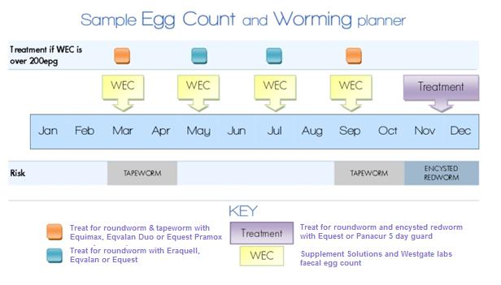
Worm Testing in Practice

Slide 35
Wormer Groups – The Options
Moxidectin: this ingredient is effective against encysted developing small redworm larvae as well as large redworm, pinworms, intestinal threadworms, ascarids (adult and larval stages) and will also treat bots.
Ivermectin: lvermectin based wormers are effective against both larval and adult stages of small redworms as well as pinworms, intestinal threadworms, stomach worms, lungworms, neck threadworms, ascarids and bots.
Pyrantel: this ingredient is effective against most adult roundworms and needs to be administered at twice the standard dose when being used for the treatment of tapeworm.
Fenbendazole/Mebendazole: these are less commonly used for worming as there is confirmed resistance to them. A five-day course of a fenbendazole-based wormer given between October and March will remove small redworm encysted larvae.
Praziquantel: this ingredient is effective against all three known species of equine tapeworm in a single dose. It is not effective against other worm types.

Slide 36
Giving Wormers to Horses
Work out the amount to administer and set the syringe
Remove the syringe cap.
Stand at the side of the animal and open its mouth with your finger
Guide the syringe into the corner of the horse’s mouth and aim it toward the back of the tongue before dispensing the wormer (not the corner or front of the mouth where the horse may just spit it out).
It may be necessary to raise the horse’s head briefly to ensure the wormer is swallowed ideally give them a treat afterwards
If administering wormers in the horse’s feed, mix the dose into part of the normal ration and if necessary adda treat to tempt the horse.
Notes:
Administration of Wormer The horse will first need to be weighed in order to determine the amount of wormer they require. This can be done using a weight tape when a weighbridge is not available. If you are using oral syringes, identify the correct dose then remove the syringe cap. Stand at the side of your horse, in front of their shoulder, and open your horse’s mouth. Guide the syringe into the corner of the horse’s mouth and aim it toward the back of the tongue before dispensing the wormer (do not dispense the wormer at the corner or front of the mouth where the horse may just spit it out). It may be necessary to raise the horse’s head briefly to ensure the wormer is swallowed. If there is any paste left, do not rub this into or around the horse’s lips. If administering wormers in the horse’s feed, mix the dose into part of the normal ration and if necessary add succulents to tempt the horse. Once the wormer has been eaten, the remaining ration can be fed.

Slide 37
Storing and Administering Product
Always check the Expiry Dates
Store according to Manufacturers Directions
Take care with any spillage
Opened syringes can be kept but check broached vial recommendations.
Dispose of the used syringes in accordance to local regulations

Slide 38
Before Prescribing SQP’s should discuss..
The Parasites
Possible Issues they Cause
What Resistance Is
Get Background Information
Check Passports
Worming Product Options

Slide 39
In addition there should be advice offered on……
Worm Seasonality’s
Using Testing For Worms
Grazing management
Using Product

Slide 40
The keys to reducing the likelihood of wormer resistance
Please use….
The right wormer
At the right dose
At the right time.

Slide 41
Acknowlagements
BHS
Pony Club
Westgate Labs
AMTRA
Vetpol
BETA

